Slide 1
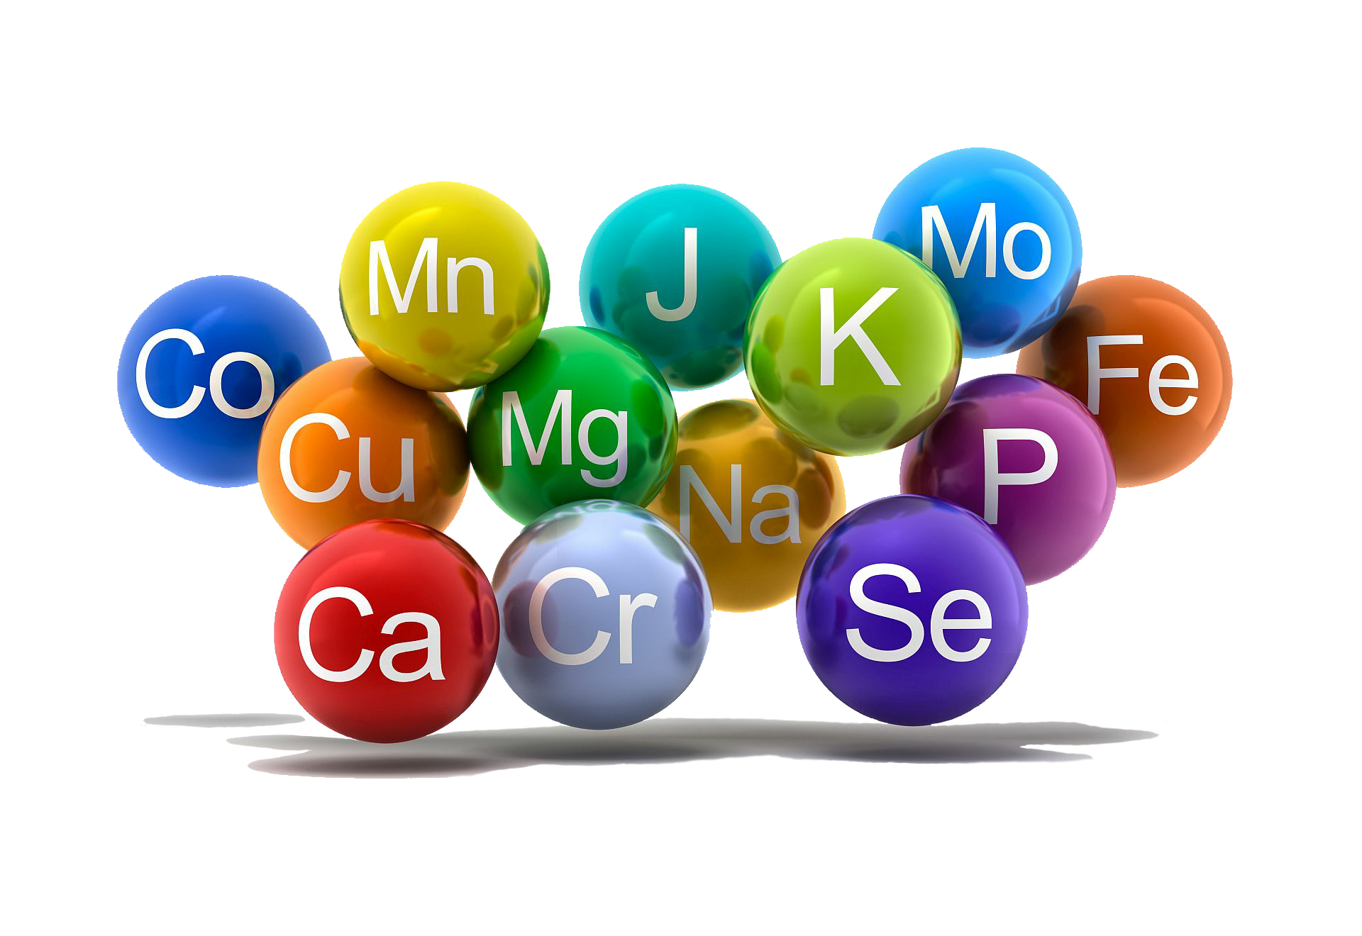
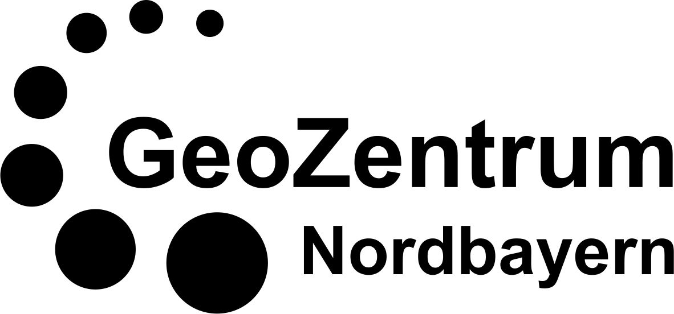
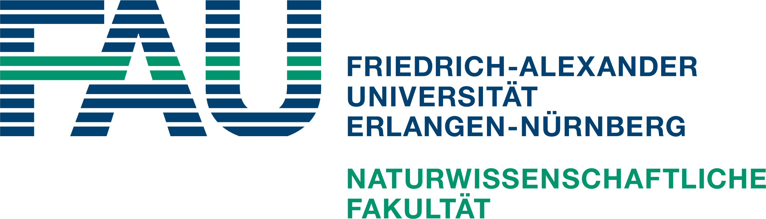
Proxies for Volcanism
Eileen Straube

Slide 2
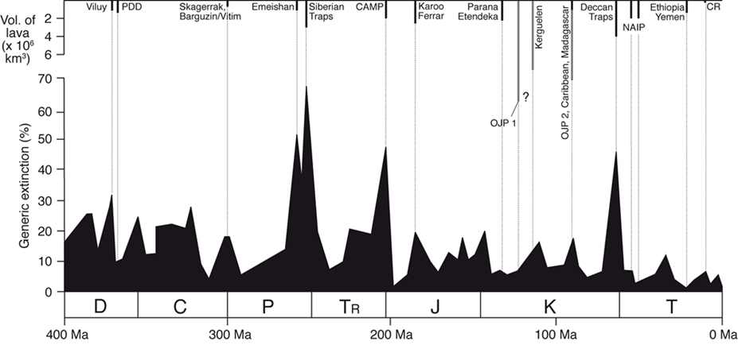
Introduction
Bond und Wignall, 2014
Time interval of the measurements:
Lower Jurassic (Pliensbachian-Toarcian boundary)
Karoo-Ferrar volcanism
Notes:
First a few things about the background:
Often a connection between Volcanism and Mass extinctions
One of such an extinction events which is correlated to volcanism took place at the Pliensbachian-Toarcian (Pl-To) border in the Lower Jurassic.
The connection to the Karoo-Ferrar volcanism is considered relatively certain today.
However, in order to be able to make such statements: proxy elements are necessary to indicate volcanic activity in the sedimentary record.
The major problem thereby is the correlation of stratigraphic heights and time because absolute dating methods like in volcanic rocks can not be applied here.

Slide 3
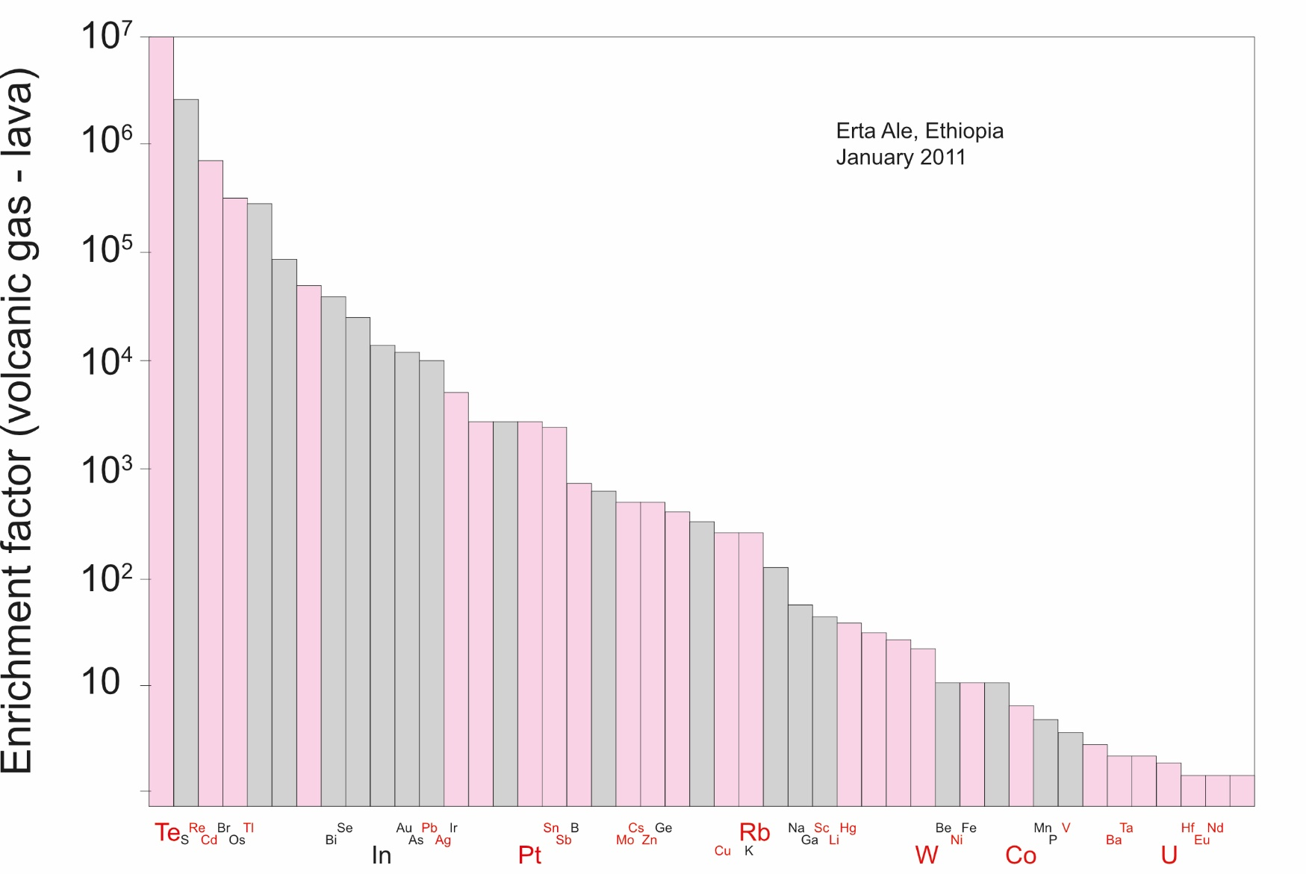
Zelenski et al., 2014
Trace elements in volcanic gases
Notes:
Here you can see which elements might be of interest for the detection of volcanic activity
These are all elements which can be found in volcanic gases
→ of interest for this project are the elements Te and Hg
so during an eruption they get into the atmosphere and will later settle into the sediment
Which leads to peaks in the concentrations of those elements in the sedimentary record
→ the sedimentary samples for this project are from:

Slide 4
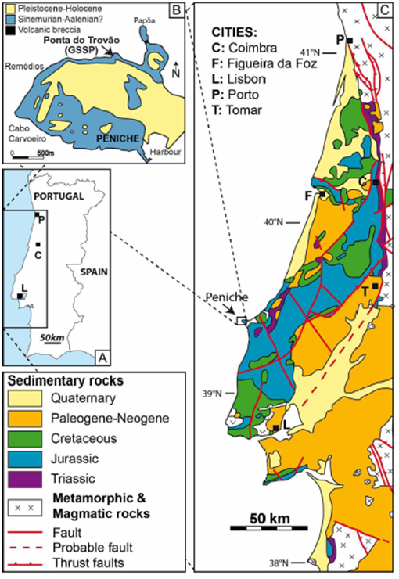
Sedimentary record
Peniche, Portugal
87 km northwest of Lisbon
Limestone-marl alternation
Place where the GSSP is defined for the Pliensbachian-Toarcian boundary
Rocha et al., 2016
Notes:
The entire sequence has no layer gaps due to the continuous sedimentation.
Peniche is also the place where the GSSP (Global Stratotype Section and Point) for the Pliensbachian-Toarcian border is defined, which offers optimal conditions for stratigraphic classifications.

Slide 5
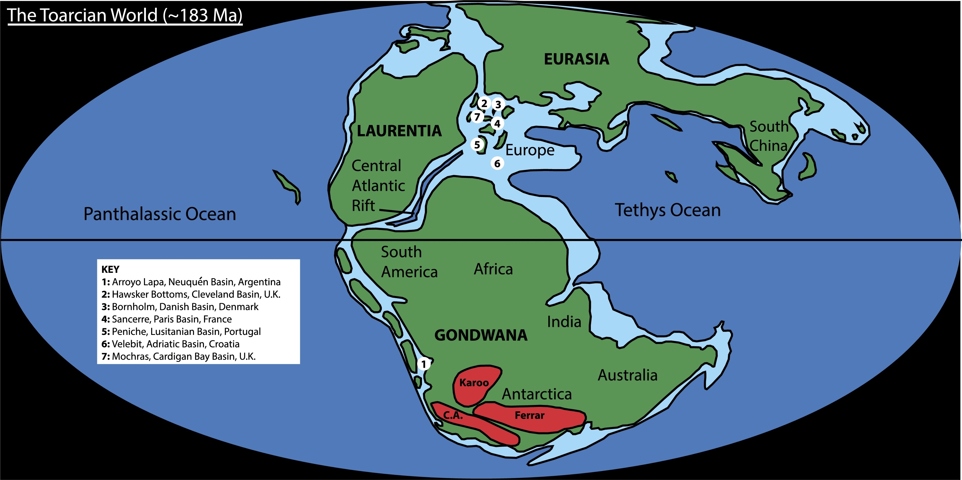
Paleogeography
Percival et al., 2015
Lower Jurassic paleogeography with the location of Peniche
and the Karoo-Ferrar province
Notes:
For a better understanding this is the geographic situation in the Lower Jurassic

Slide 6
The Aim of the Project
→ compare Te and Hg to identify which one is the better proxy for volcanism

Slide 7


Hypothesis
Tellurium is a better proxy for volcanism than Mercury

Slide 8
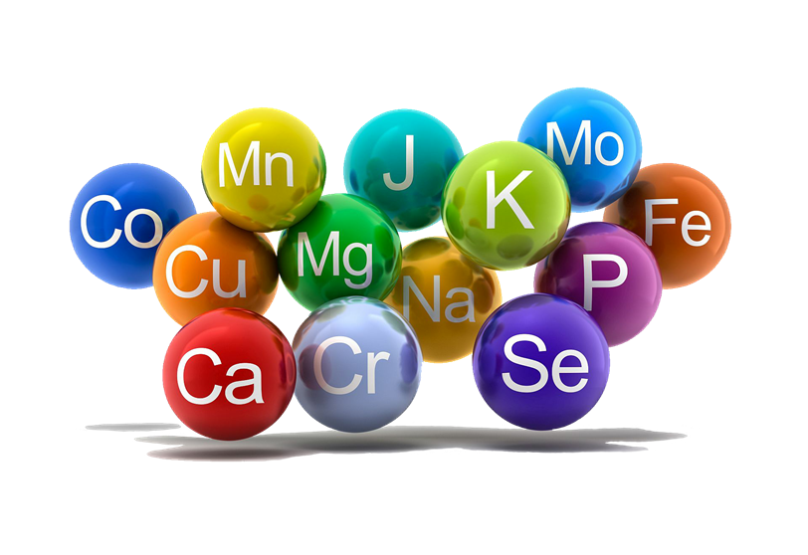
Procedure
1. Age Model for Proxy Data
Age model of Sell et al. 2014 forms the base
Data:
Tellurium measurements (Te/Th ratio) from Peniche
Mercury measurements (Hg/TOC ratio) from Peniche
transform stratigraphic heights into ages with the DAIME package function “pointtransform”
→ Outcome: Te and Hg measurements correlated with ages

Slide 9
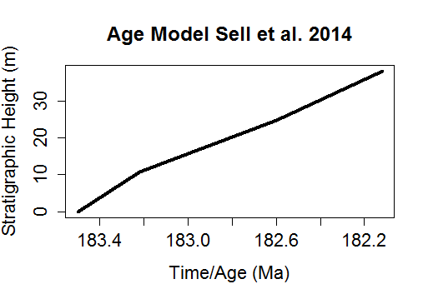

Slide 10
Procedure
1. Age Model for Proxy Data
Age model of Sell et al. 2014 forms the base
Data:
Tellurium measurements (Te/Th ratio) from Peniche
Mercury measurements (Hg/TOC ratio) from Peniche
transform stratigraphic heights into ages with the DAIME package function “pointtransform”
→ Outcome: Te and Hg measurements correlated with ages

Slide 11
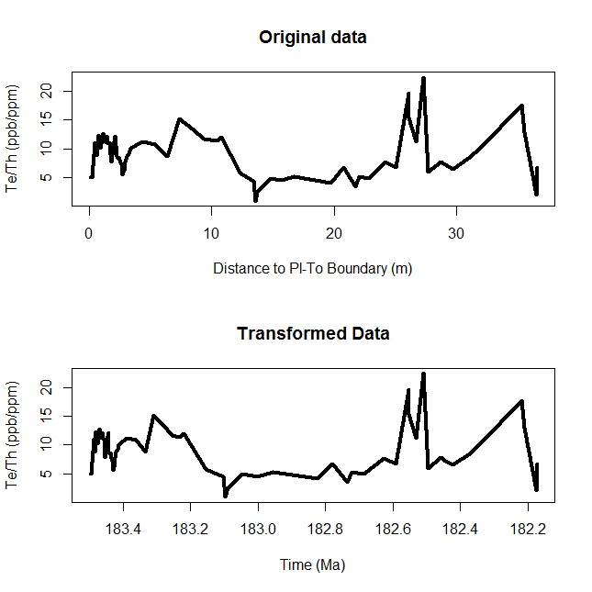
Pl-To Boundary

Slide 12
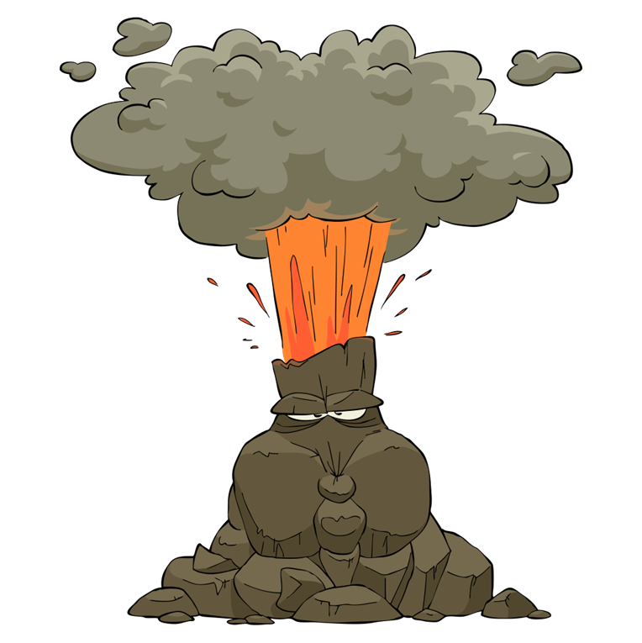
Procedure
2. Age Distribution of Volcanism
Data: absolute dating methods
Method 1: U-Pb measurements from Burgess et al. 2015
Method 2: Ar-Ar measurements from Jourdan et al. 2008
generate normal distributions for each point of U-Pb or Ar-Ar measurements, respectively
finally combine the distributions for each data set
→ Outcome: distribution of volcanism through time

Slide 13
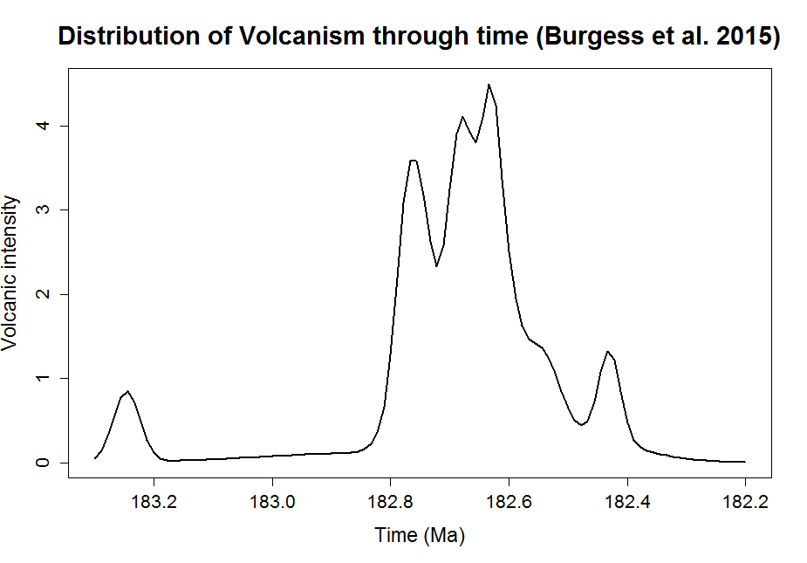

Slide 14
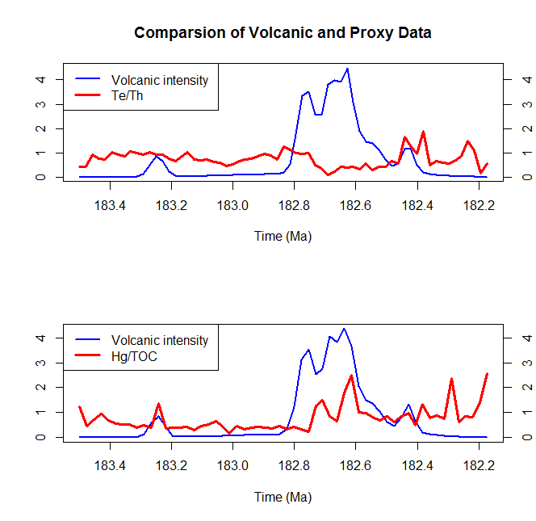
Pl-To B.
Pl-To B.

Slide 15
Procedure
3. AIC (Akaike Information Criterion)
Methods:
U-Pb measurements from Burgess et al. 2015
Tellurium measurements (from Peniche)
Mercury measurements (from Peniche)
Ar-Ar measurements from Jourdan et al. 2008
Tellurium measurements (from Peniche)
Mercury measurements (from Peniche)
calculate the AIC for each method and proxy separately

Slide 16
Results
Method 1: U-Pb (Burgess et al. 2015)
Tellurium: AIC= 39.77
Mercury: AIC= 90.64
Method 2: Ar-Ar (Jourdan et al. 2008)
Tellurium: AIC= 45.55
Mercury: AIC= 94.28

Slide 17
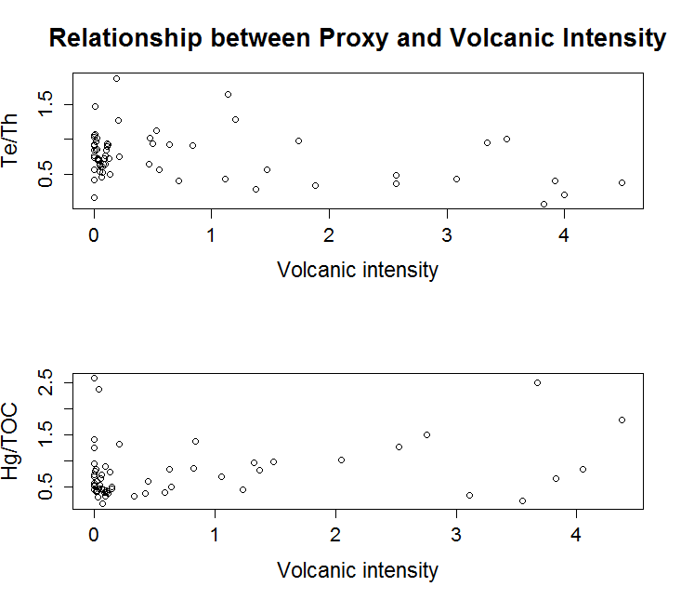

Slide 18
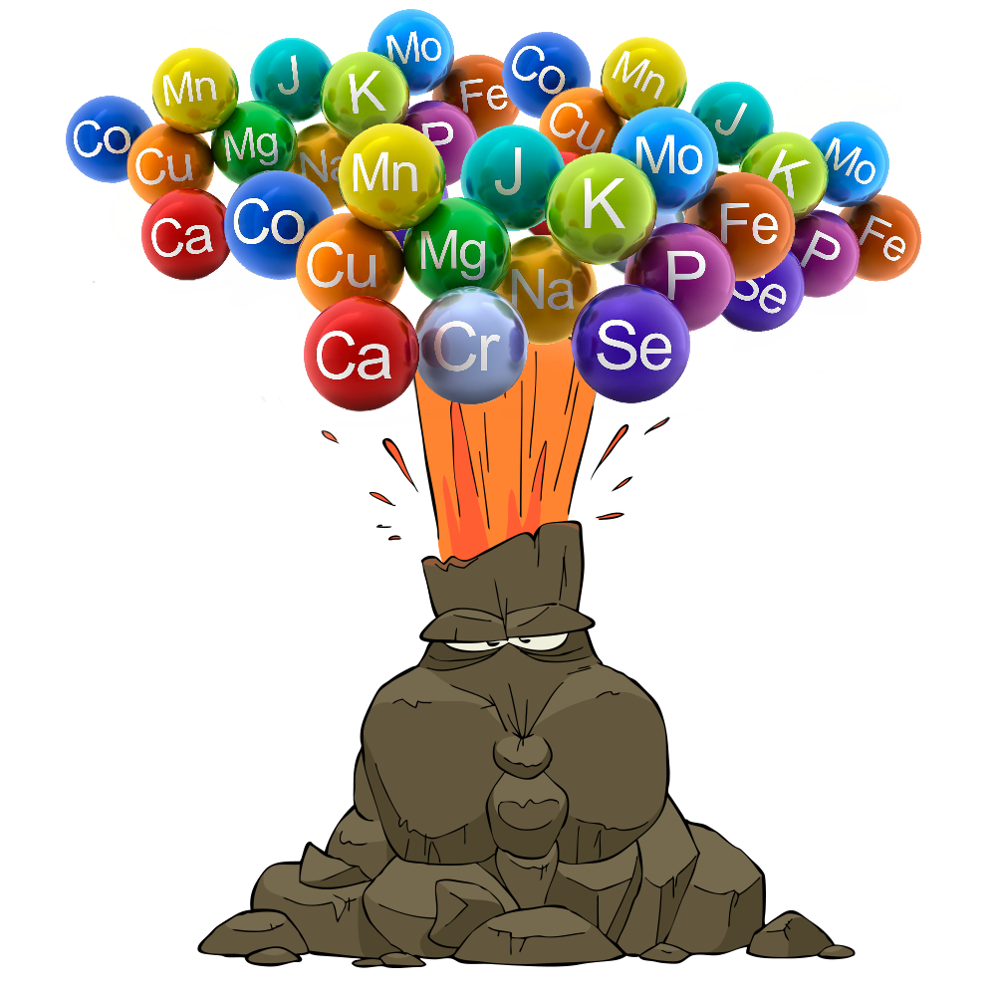
Which proxy is better?
AIC has some limitations in this case
due to the requirement of a model
comparing the graphs
Mercury seems to be the better proxy

Slide 19
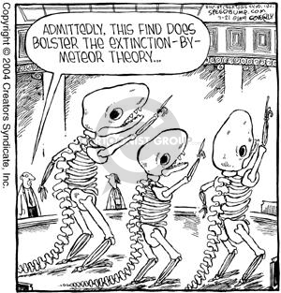
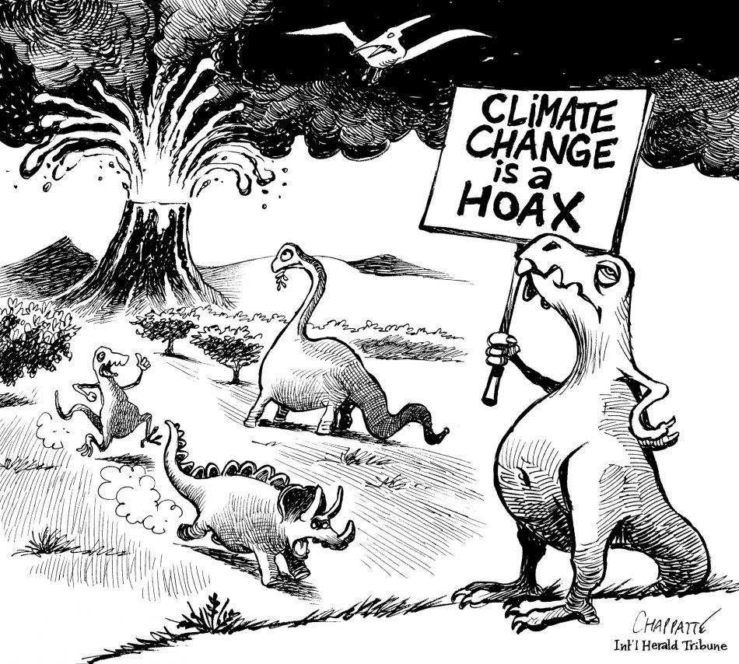
Conclusion
good method to identify proxies is very useful
helps to determine environmental perturbations in the sediment
→ to find the causes of extinctions

Slide 21
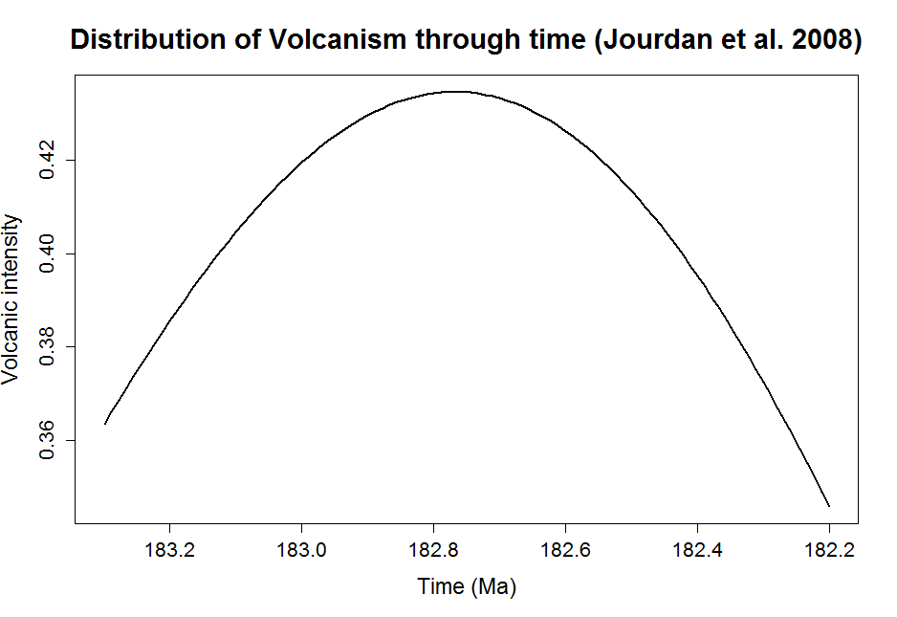

Slide 22
